Slide 1
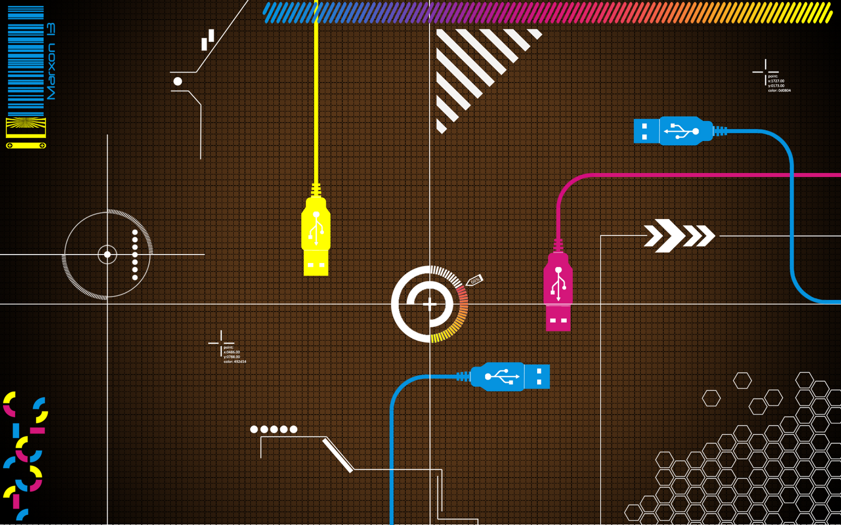
DATA MINING
SOHAM PAL
S ADITI APURVA
ROHIT PARASHAR
VIVEK KUSHWAHA

Slide 2
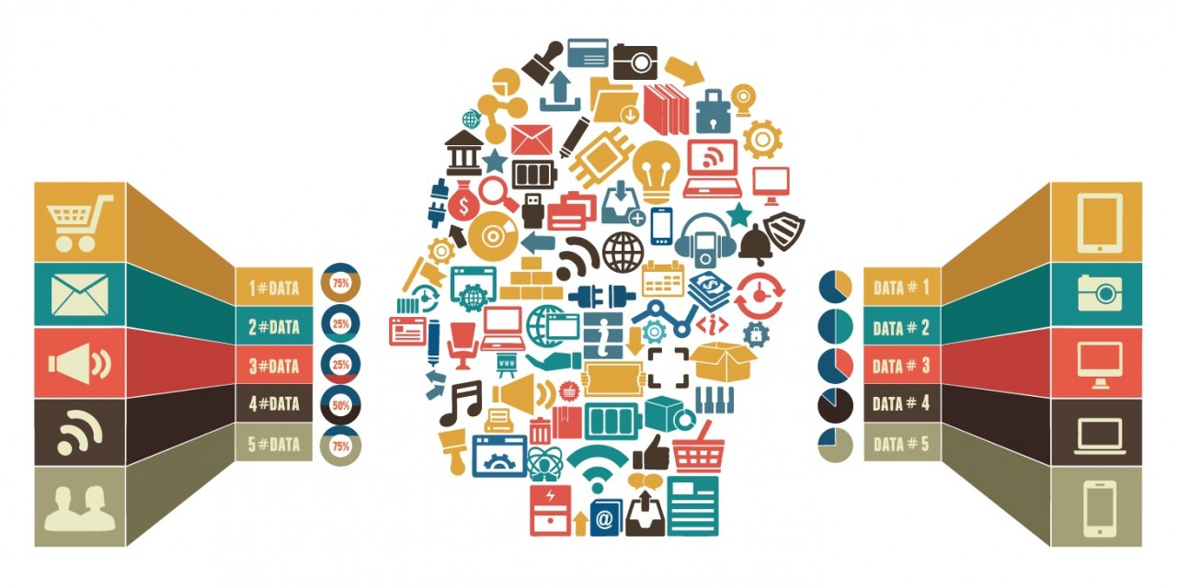

Slide 3
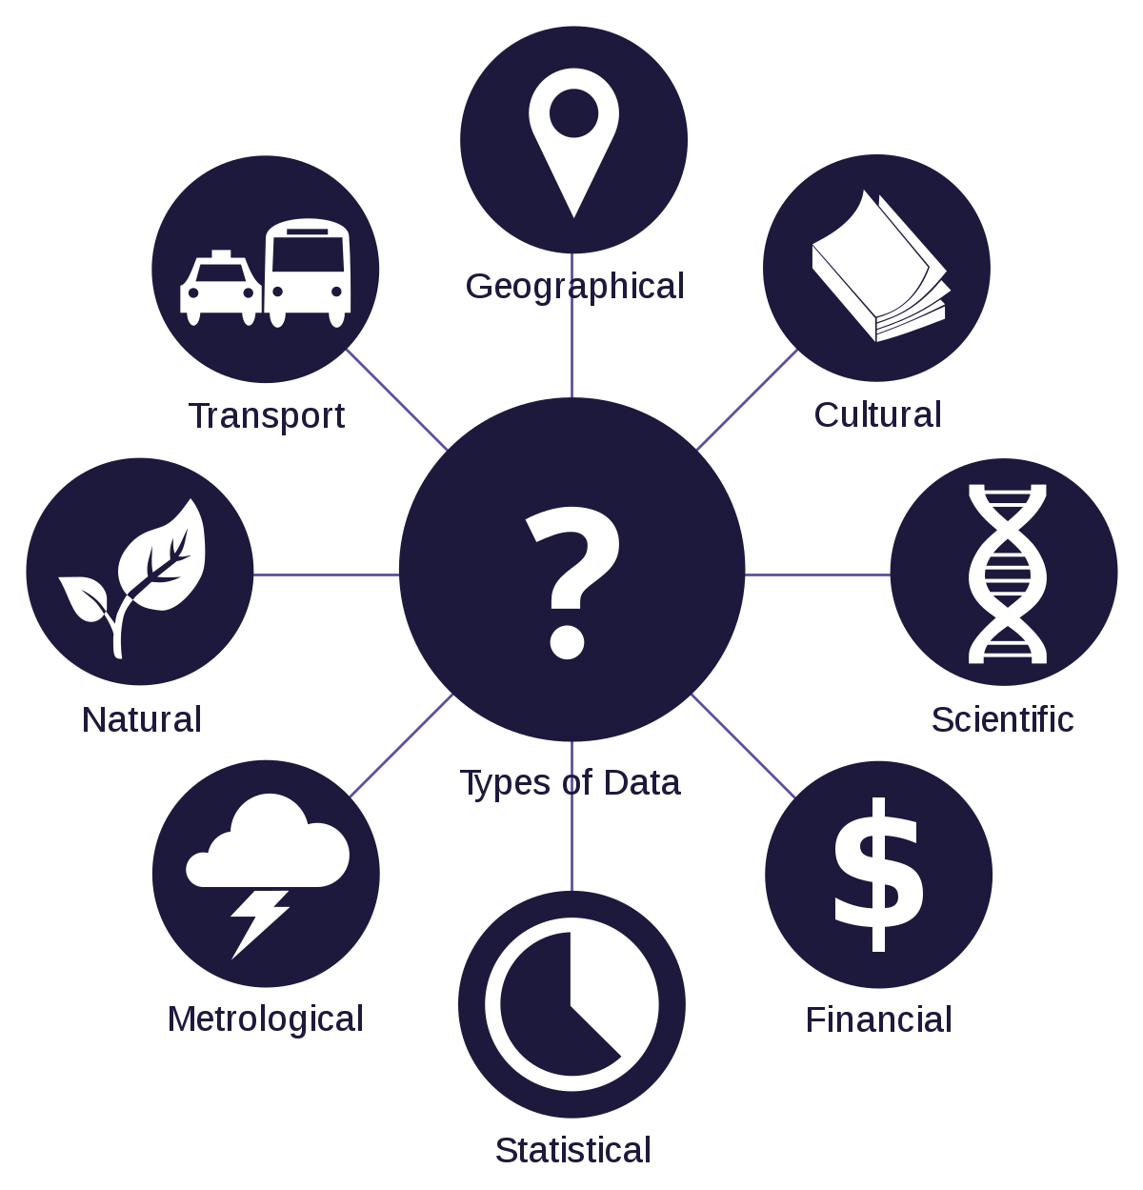

Slide 4


GOOD OR BAD…
THAT IS THE QUESTION

Slide 5

BAD DATA BAD DATA EVERYWHERE

Slide 6
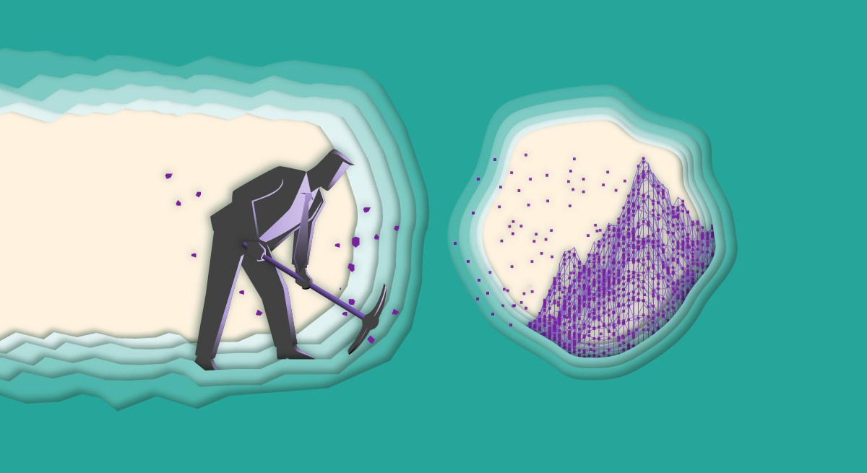
DATA MINING

Slide 7
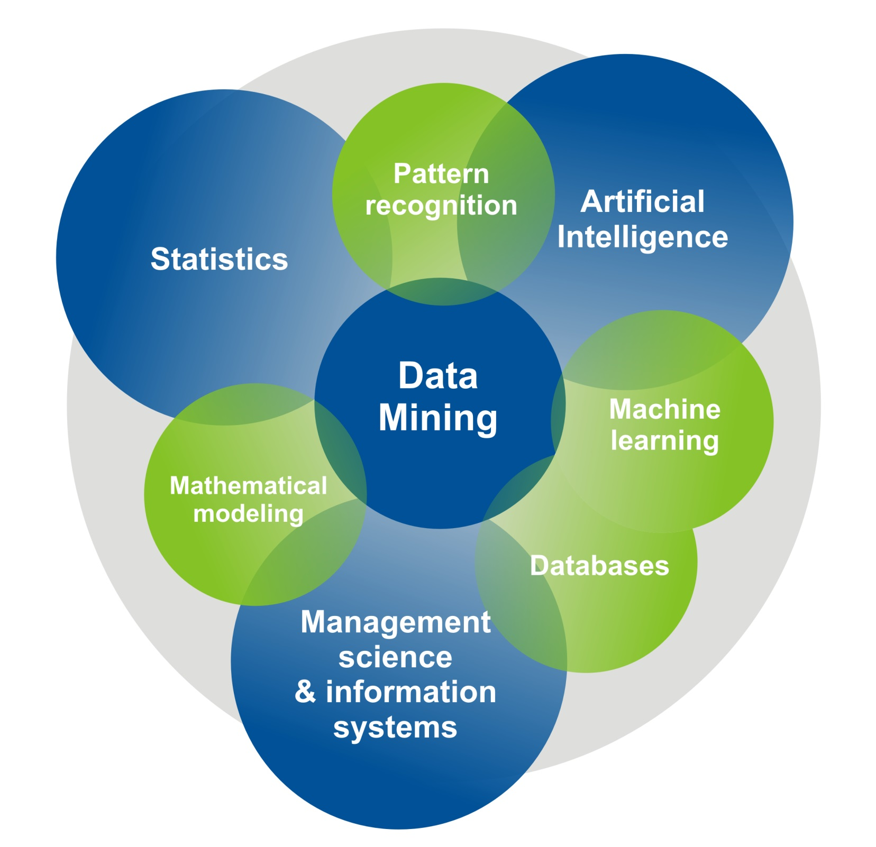

Slide 8


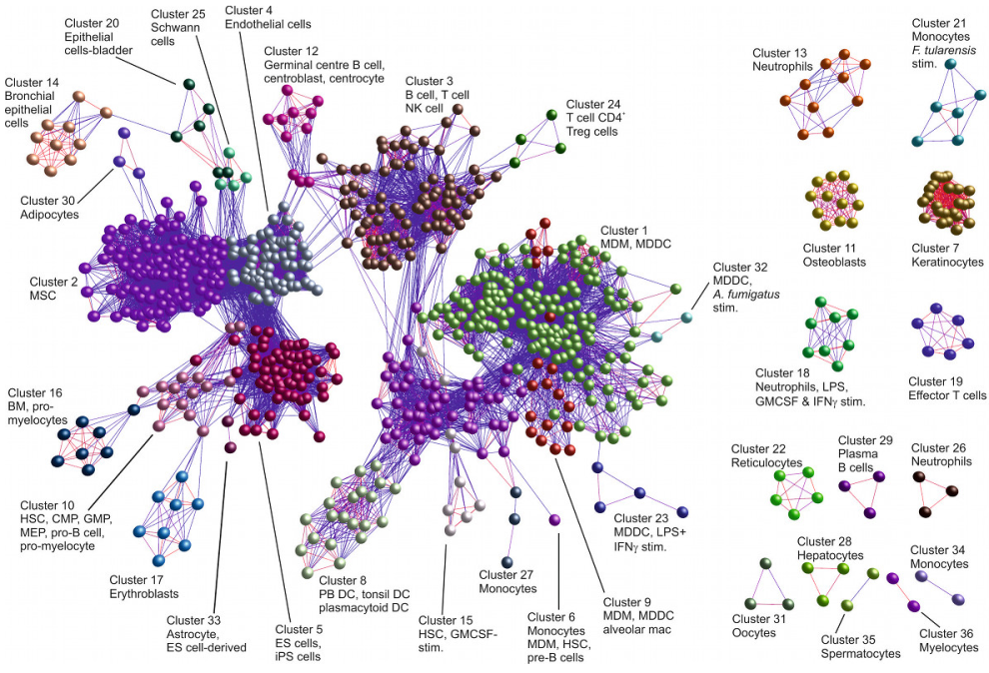
TELECOMMUNICATION INDUSTRY BIOLOGICAL DATA ANALYSIS

Slide 9
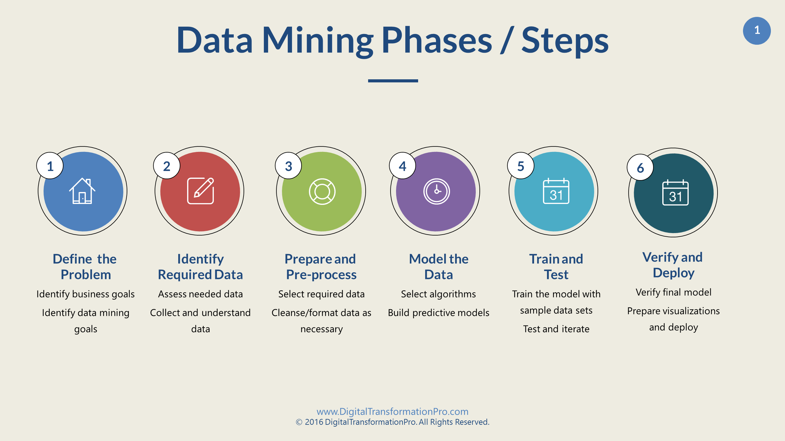

Slide 10
DATA MINING TECHNIQUES
1Association
2.Classification
3.Clustering
4.Prediction
5.Sequential patterns
6.Decision tree

Slide 11






DATA MINING TOOLS

Slide 12
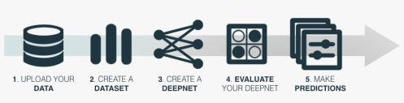
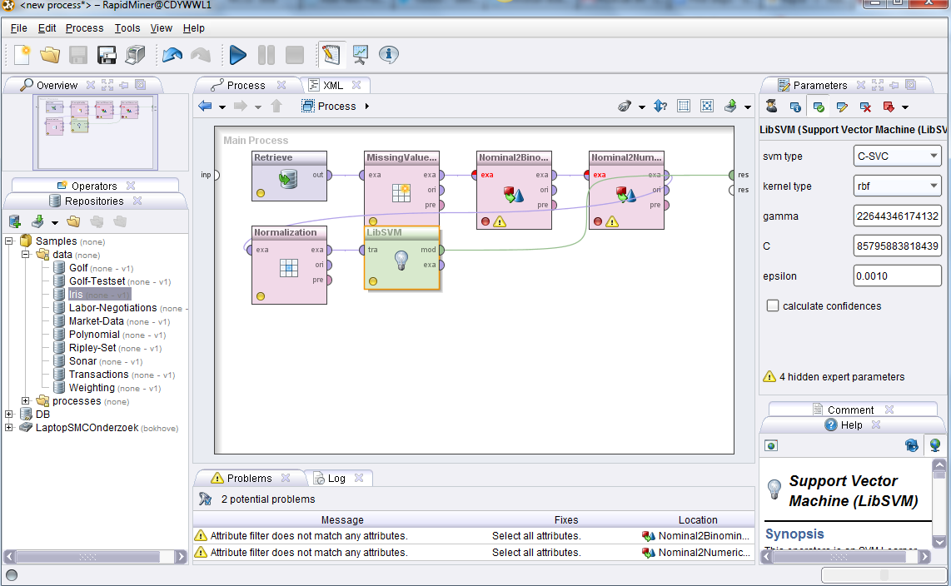
RAPID-MINER MINING PROCESS

Slide 13
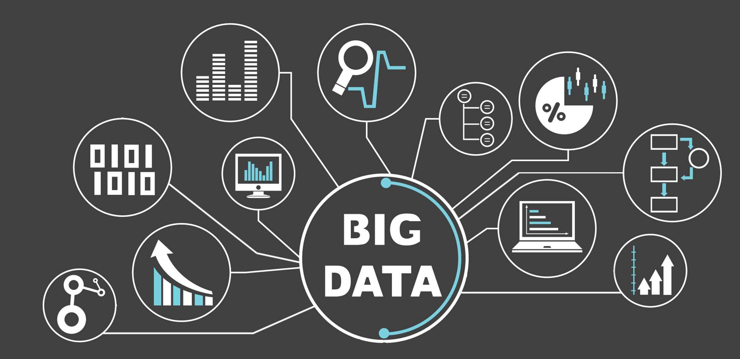
DATA MINING IN BIG DATA

Slide 14

DATA MINING IN A.I.

Slide 15
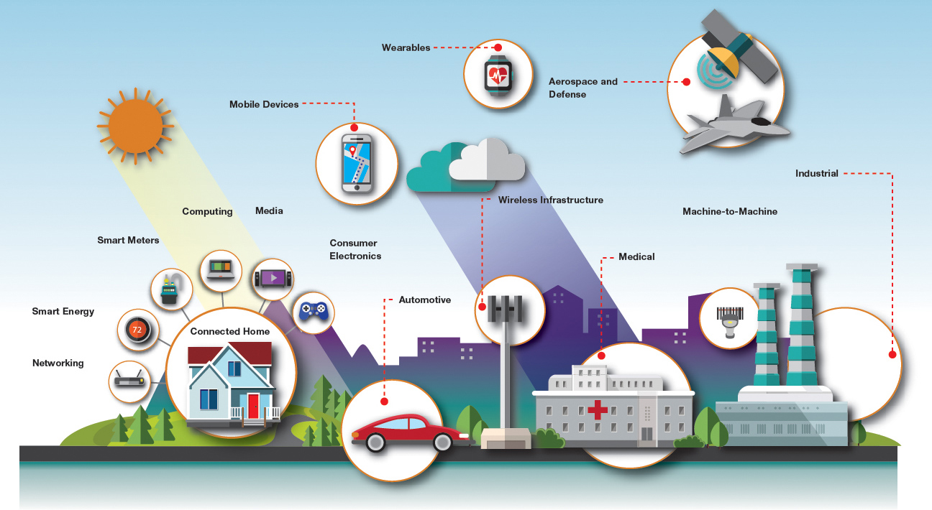
DATA MINING IN IOT.

Slide 16
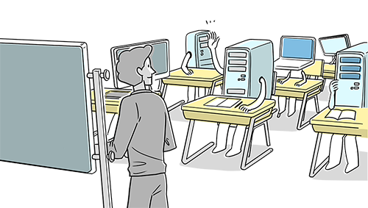
DATA MINING IN MACHINE LEARNING

Slide 17

ALL TECHNOLOGIES ARE CONNECTED

Slide 18

TECHNOLOGIES ARE EVOLVING
DATA IS INCREASING
THE NEED FOR DATA CLEANING AND STRUCTUING INCREASES
THUS
MINING
INCREASES

Slide 19



Slide 20


